Slide 1
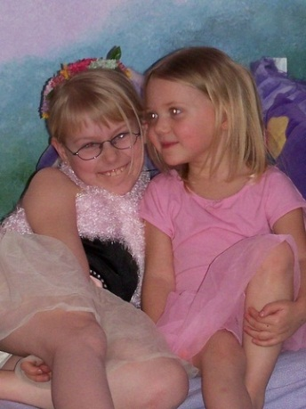
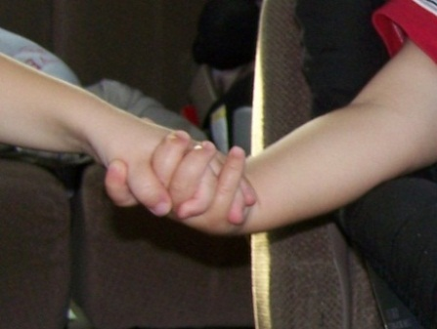
Incorporating “Conscious Discipline” Into My Classroom Management
By Sarah Weston, July 2012
Notes:
Over the course of my last two years teaching in a Great Start Readiness Program for at-risk preschoolers, as well as my prior experiences subbing in kindergarten and young 5’s, I have realized that many of the behavior issues I have dealt with are due to a lack of social skills. The material presented in this course reinforced this belief. According to Jones & Jones, social skill training “… is almost always needed for students who are having serious behavior problems” (2010, p. 389). Development of this PowerPoint has served as a tool to help me think about how I will be integrating the ideas I have learned this summer into my teaching practice. As consistency is a key component of any behavior plan, I will be sharing my presentation with the paraprofessional who teaches me. I may also share portions of my presentation with parents.

Slide 2
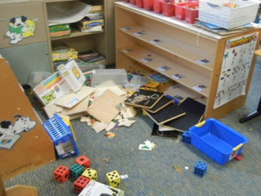
This picture was taken after an upset student threw a tantrum, dumping all of the puzzles and games onto the floor.
Clearly, my student needed help.
As his teacher, it’s my job to help him.
As seen from this picture, “my help”, wasn’t working very well!
I enrolled in Psychology of Classroom Behavior Course, determined to become a more effective teacher. While researching ways to help my students acquire social skills, I discovered the Conscious Discipline Program by Becky Bailey. I was amazed at the similarities between Bailey’s program and the classroom management strategies discussed in my class. Bailey’s principles made sense and were age appropriate.
Notes:
Before beginning my slideshow, I wanted potential viewers to understand what prompted me to learn about Conscious Discipline and why I was desperate to become a better teacher.

Slide 3
My Preschool Students
First school experience
First social experience with other kids
Diverse population with diverse needs
Besides academic goals, they need to learn to follow directions and interact with other kids
Notes:
Teaching in a GSRP program, I get the opportunity to meet students’ families during home visits before school starts. During my visits, many parents are excited their child will be coming to school because they don’t get to play with other kids. “It is imperative to develop skills that will assist you in increasing the frequency with which students who have a history of challenging adult requests will respond calmly and reasonably to your reasonable and professionally presented requests (Jones & Jones, 2010, p. 299).”

Slide 4
Misbehavior
Occurs when a child’s needs are not met
Is caused by a skill deficit
Shows a child needs help learning a new way to handle a situation
“Students’ behaviors need to be approached in a manner similar to academic skills (Jones & Jones, 2010, p. 175)”
Example: If a child can’t read, we teach him to read. If a child can’t share, we should teach him to share.
(Jones & Jones, 2010)
Notes:
In order to understand the approaches I will be implementing into my classroom, it is important to understand that misbehavior is due to a skill deficit.

Slide 5
Focus on Problem Solving, Not Punishing
“… a focus on punishment appears to inhibit learning. Students in classrooms in which teachers are judged as more punitive tend to express less value in learning, be more aggressive, and learn less.”
“… research suggests that punishment is not an effective method for changing student behavior.”
“Punishment tends to create a situation in which the student becomes angry or blames the individuals responsible for the problem.”
(Jones & Jones, 2010, p. 326)
Notes:
In addition to explaining what children misbehave, it is also important to understand that research has shown punishment doesn’t typically fix behavior problems.

Slide 6
What is Conscious Discipline?
Based on brain research and child development
Creates proactive teachers through self-control
Integrates social skills into classroom management
Models life values
Uses frustrating situations as learning opportunities.
Fosters appropriate behavior through classroom structures
Improves school climate (Hoffman, 2009)
1
Notes:
I was impressed by the many considerations Bailey took into account when developing Conscious Discipline. In the past I have incorporated social skill instruction through the use of books, but it wasn't enough. Due to the population I serve, I have learned I need to intertwine social skills and classroom management throughout my whole classroom to help my students achieve self-regulation and social skills. Teaching them specifically how to interact and communicate will give them the skills they will need to work together in the future.

Slide 7
Professor of education Thomas R. McDaniel states, “… I would use Becky A. Bailey’s Conscious Discipline as the single text…” in teaching a graduate classroom management course “…because it does a masterful job of coordinating and integrating a wide variety of models of discipline into a unified, comprehensive classroom management system…” (McDaniel, 2008, p. 282).
Notes:
Before implementing a classroom management program or technique, it is important to consider its validity. In my case, I spoke with two colleagues, and my course instructor. Additionally, I also searched for journal articles that were written from an unbiased opinion.

Slide 8
Based On Child Development Theorists
Jean Baker Miller
Jean Piaget
Lev Vygotsky
Eric Erickson, Carol Rogers, and Abraham Maslow
Arnold Gesell
B.F. Skinner & Albert Bandura
(Bailey, 2011)
Notes:
As I continued my search for information, I came across Bailey’s article The Theoretical and Scientific Basis of Conscious Discipline. Through her explicit connections between the theorists and Conscious Discipline, I realized she based her program on many of the same theories that were used in the development of the Jones & Jones text (2010) I read for my class.

Slide 9
Self Control
Before I can expect my students to have self-control, I must have it myself.
Bailey explains 7 powers that are an imperative part of her program.
I have spent the summer integrating them into my life.
I have included a brief overview of them.

Slide 10
Seven Powers for Self Control
Power of Perception: No one can make you mad without your permission
Power of Unity: We are all in this together
Power of Attention: What you focus on, you get more of
Power of Free Will: The only person you can make change is yourself
Power of Love: See the best in others
Power of Acceptance: The moment is as it is
Power of Intention: Conflict is an opportunity to teach
(Bailey, 2001, pp. 14-15)
Notes:
Incorporating these “powers” into one’s thinking takes time, commitment, and knowledge of the various principles Bailey explains in her book (2001). I initially considered skipping them all together in my presentation. However, as they are the building blocks for the program, I felt they should be included.

Slide 11
From the Seven Powers for Self Control emerge the Seven Basic Skills Of Discipline
Composure: Becoming the person you want children to be
Encouragement: Building a school family
Assertiveness: Saying “no” and being heard
Choices: Building self esteem and willpower
Positive Intent: Creating teaching moments
Empathy: Handling the fussing and the fits
Consequences: Helping children learn from their mistakes
(Bailey, 2001, p. 15)
Notes:
According to Bailey, “These are the only skills a teacher needs to constructively respond to any conflict in the classroom (2001, p. 15)“. I think it would take a few years of implementation to get the principles down before I could agree or disagree with Bailey’s statement. However since the principles and techniques in Bailey’s book correlate with many of the ideas discussed in our course and in our texts, I think they are important skills to incorporate into my teaching. Comparing the seven basic skills of discipline to the 40 developmental assets in Jones & Jones, I observed that many of these skills fit into the assets associated with “healthy personal development” (2010, pp. 41-44).

Slide 12
Appropriate responses to conflict instills life values, consequently teaching social skills
Seven essential life values
Integrity
Interdependence
Respect
Empowerment
Diversity
Compassion
Responsibility
(Bailey, 2001, p. 16)
Seven basic social skills
Anger Management
Helpfulness (kindness, sharing)
Assertiveness
Impulse control
Cooperation
Empathy
Problem solving
(Bailey, 2001, p. 16)
Notes:
“Studies on school and teacher effectiveness have demonstrated that teachers and schools have a major impact on how students behave and learn and on how they feel about themselves (Jones and Jones, 2010, p. 29).” The main function of a formal education is to prepare students for the future (Jones & Jones, 2010). By teaching/modeling life values I am not just creating a safe classroom, I am preparing children for the future.

Slide 13
Skill 1 Composure: Becoming the person you want children to be
“An inappropriately angry teacher response creates tension and increases disobedience and disruptive behavior” (Jones & Jones, 2010, p. 305).
Anger may reinforce a child’s misbehavior (Sprick, 2009, p. 406).
I must attain self-control before I can expect my students too.
“The brain functions optimally in safe environments” (Bailey, 2001, p. 25)
Notes:
When responding to misbehavior, one of the most important communication skills is to stay calm (Jones & Jones, 2010).

Slide 14
Self Control
Requires being aware of your own thoughts and feelings
Bailey recommends: “Breathe in and say to yourself, “No one can make me angry,” then exhale and say to yourself, “without my permission.” (2001, p. 25)”
(Bailey, 2001)
Notes:
When threatened we become defensive or helpless (Jones & Jones, 2010). When I stay calm, not only will it be easier for me to help my students, but it helps reduce inappropriate student responses.

Slide 15
Stress
Stress and trigger thoughts come before an angry response. (Example: He always throws fits!)
Children need the skills to handle stress
Incorporate stress reduction strategies into classroom structure
Social stress is reduced through aggression (bullying) or through affiliation (a sense of belonging).” (Bailey, 2001, p. 51)
(Bailey,2001)
Notes:
Children that are considered “at-risk” have more anxiety and stress in their lives, and often lack the skills to appropriately handle their emotions (Bailey, 2001; Jones & Jones, 2010).

Slide 16
Circle Time “The Brain Smart Way”
Activity to unite
Singing, pledge of allegiance
Activity to disengage the stress response
Deep breathing and stretching
Activity to connect the children to the teacher and each other
Incorporate touch and eye contact, movement activities
Activity to commit oneself to learning
(Bailey, 2001, p. 34)
Notes:
When I was investigating the Conscious Discipline website, I was impressed by the many teacher tools available (unfortunately, most for purchase), that coordinated with the principles I will be using with my students. These tools, including books and music, could easily be incorporated into our daily activities, supporting life skill development.

Slide 17
Breathing Techniques
Help alleviate stress by relaxing body
Can be used as whole group activity or with an individual child
Beneficial when used before stressful or exciting activities
(Jones & Jones, 2010)

Slide 18
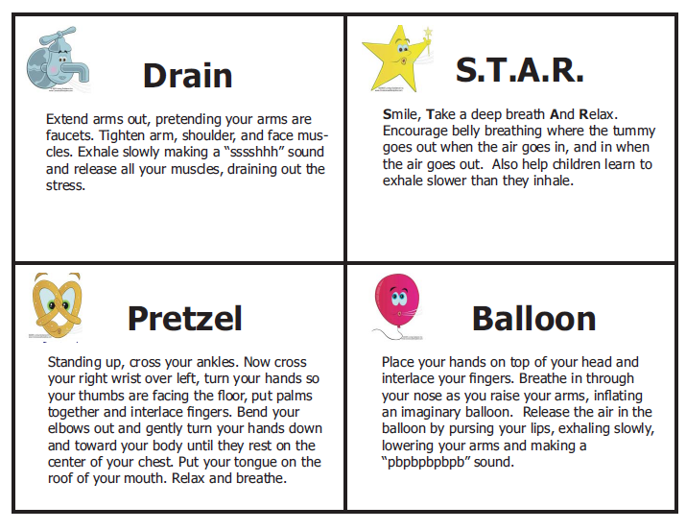
Breathing Techniques
Drain, Pretzel, and Balloon are relaxation techniques to reduce stress.
S.T.A.R. is a tension reducing breathing activity to use when upset
(Loving Guidance, Inc., 2005)
Notes:
I love the visual representations of these techniques, and will be putting them up in my classroom. As I am a visual learner, as is my son, I know first hand how important it is to provide visuals. I also thought it was easier to include them on a slide instead of trying to explain them. They are included in the free resources on Conscious Discipline website. Assuming my students like they, I will also send them home. I have strived to reference everything I have included in this PowerPoint, especially considering the fact that Bailey’s material in copyrighted.

Slide 19
Create A Psychologically Safe Classroom
Tell students: “My job is to keep the classroom safe so you can learn. Your job is to help keep the classroom safe.”
Create a “Safe Place” for students to go when they are upset.
I plan to include a bean bag chair, stuffed animal, and breathing icons; I will teach procedures for using this area.
(Bailey, 2001)
Notes:
By repeatedly talking about safety, and the fact that my job is to keep our room safe, I will help my students feel safe. Additionally, when there are conflicts, I can relate them back to the importance of safety.

Slide 20
Skill 2 Encouragement: Building a school family
Fosters sense of belonging (Bailey, 2001)
Creating a school where students feel cared, competent and valued prevents school violence. (Jones & Jones, 2010)
Brain research shows students learn best in caring and respectful communities where children know each other. (Jones & Jones, 2010)

Slide 21
Routines
Provide predictability
Consistency is essential
Post routines in pictures
Should be taught systematically
(Bailey, 2001, p. 60)
Rituals
Connect us
Have a calming effect
Examples:
Greeting/Closing
Lost tooth
Birthdays
New sibling
(Bailey, 2001, pp. 61-63)
Notes:
Jones & Jones (2010) as well as Sprick (2008) discuss the importance of creating routines and rules which are strategically taught to students. Explicit expectations and routines are essential to maintaining a calm, productive, and successful classroom.

Slide 22
Visual Supports
“Young children encode information in pictures” (Bailey, 2001, p. 153)
Post Rules where students can see them
Picture Rule Cards remind children of expectations and choices. Example: You may sit with your hands on your lap, or hands on your knees.
(Bailey, 2001)

Slide 23
School Family Development
Ways to be helpful book
Children draw pictures of ways they help keep school safe
Friends and family board
Helps students get to know each other and feel safe
Job board
Children contribute to the classroom; jobs include social and emotional needs such as erasing board and greeter
(Bailey, 2001, pp. 66-71)
We Care Center
Children create notes/cards for others (Bailey, 2001, p. 220)
Notes:
Taking the time to focus on developing relationships within our school family promote social skills and a positive school environment where students feel accepted.
Reading of our course text by Jones & Jones (2010) has taught me the following: Development of interpersonal relationships increases motivation and relationship as students feel they have positive and supportive relationships. Good peer relationships increases motivation and academic achievement, creates an environment students are comfortable taking risks in, and decreases misbehavior. A positive classroom community is essential to developing the three C’s students need: Connectedness (being known and valued), Competence (being capable), and contribution (being able to exert control).

Slide 24
Comment on kind deeds
Explicit comments let children know what they did that was helpful.
“You _____________ so _________________. That was helpful (--kind,--caring, --thoughtful).” (Bailey, 2001, pp. 71-72)
Example: “You picked up the book so it didn’t get stepped on. That was helpful.”
Notes:
Using explicit comments allows children to understand what it was they did that was helpful, and allows them to take responsibility for their actions (Jones & Jones, 2010).

Slide 25
Descriptive Praise
Describe what you see
Follow with a “tag”.
“That took determination.”
“That was gutsy.”
“You sure are organized.”
“That was helpful.”
“That was thoughtful”
“That was kind, caring, loving, etc.”
(Bailey, 2001, p. 83)
Notes:
Descriptive praise provides encouragement and acceptance without judging behavior. By not judging children, I am helping them to become intrinsically motivated, and responsible for themselves. In the past, I would say things such as, “I like the way Kylie is sitting on the rug.” I now realize that by wording my praise like that, I gave the impression I liked her because she was sitting nicely. By using encouragement, I model unconditional acceptance of my students.

Slide 26
Encourage children when they make poor choices
Everyone makes poor choices.
Instead of lecturing, encourage child to fix problem.
“We all make mistakes. What could you do now that would be helpful?”
“You can do it.”
(Bailey, 2001, p. 85)
Notes:
By Allowing mistakes to be a learning tool, my students will learn that their actions have a cause/effect relationship. They will learn ways to fix problems as well as ways to make the best of a hard situation.

Slide 27
Demonstrate misbehavior is a “call for help”
Children develop perceptions about other students based on how we respond to misbehavior. (Bailey, 2001; Jones & Jones, 2010)
Give a motive to the aggressor as a “call for help” (Bailey, 2001)
Example: Child is throwing toys, say to them: “You seem to feel angry today. What could you do that would help you feel better?”
Notes:
“Studies on school and teacher effectiveness have demonstrated that teachers and schools have a major impact on how students behave and learn and on how they feel about themselves (Jones and Jones, 2010, p. 29).”

Slide 28
Skill 3 Assertiveness: Saying “no” and being heard
“Create descriptive mental images” to indicate what child should do (Bailey, 2001, p. 97)
“… it is generally more effective to request that a student initiate an action rather than terminate an action” (Jones & Jones, 2010, p. 310).
Example: “Pick up the blocks” versus “Don’t step on the blocks”

Slide 29
Assertive Commands
Use “assertive commands” (Bailey, 2001, p.111)
A request is a question
A command is expected
Example: “Bring this to the library” versus Would you bring this to the library?

Slide 30
“I Message” Strategy
Nonjudgmental, informs about problem
Describes behavior and feelings
Helps children to understand others’ perspective (Jones & Jones, 2010, p. 36)
“I don’t like it when you _____” (Bailey, 2001, p.120)

Slide 31
Use Tattling as a Teaching Tool
Kids tattle because they feel powerless, unsafe, or angry because something didn’t go their way.
Empower victim, asking “Did you like it?” (Child responds with “no”)
Tell child: “Go tell Emma, “I don’t like it when you hit me.”
For children who are less confident, have them practice first, using their “big voice” before they go to the aggressor.
(Bailey, 2001)
Notes:
By following this technique I teach my students to appropriately stand up for themselves, while also giving support to students who need it. It is important to model the words for my students, not just tell them to use “their words”.

Slide 32
Skill 4 Choices: Building self esteem and willpower
Choices give child power (Jones & Jones, 2010)
Give two positive choices versus using a positive
and a negative (Bailey, 2001, pp. 141-142)
Use when a child is not following directions (Bailey, 2001, pp. 141-142)
Notes:
According to Jones & Jones (2010), giving choices helps children feel competent. I have used choices in the past with my students, and have found it beneficial. However, I did not always give two positive. Based on Bailey’s (2001) description of using choices, I now realize that by giving a child one positive and one negative, wasn’t really giving them choices, I was manipulating them.

Slide 33
Bailey’s Two Choices Technique
First take a breath to calm yourself; decide what you want child to do
Say, "You have a choice” in a positive voice. “You may _______ or you may ________.”
Get commitment, “What is your choice?”
Observe choice. “You chose ______!”
(Bailey, 2001, pp. 141-142)

Slide 34
Skill 5 Positive Intent: Creating teaching moments
“Children are either extending love or calling for love (help).” (Bailey, 2001, p. 163)
Attribute positive motives to prevent defensive reactions
Change resistance into cooperation
Example: “You wanted the toy and you didn’t know what to do, so you hit him.”
Notes:
Positive internet turns problems into teaching moments, fostering security, responsibility, accepts diversity, acceptance. I felt Bailey’s strategy of positive intent had similar components to the step in a Functional Behavior Assessment where you develop a theory about the function of a child’s behavior. Though a much simpler procedure, both involve considering why a child is behaving a specific way, and using that information to help the child develop an appropriate way of attending to their need.

Slide 35
Skill 6 Empathy: Handling the fussing and the fits
Reflect what you see, feel and hear
Allows child to calm down and problem solve
Prevents “Flight or Fight”
Example: “Your face is red and you are kicking the locker. You seem angry.” (Child responds) Mirror back their response
(Bailey, 2001, pp. 214-215)
Notes:
Working on my project, I realized my vision was larger than I had anticipated. Unsure of how to proceed, I continued to work on it, focusing on the areas I felt were the most important. Unfortunately, skill 6 is not receiving as much attention as I am out of time. I do plan to finish it for my own use.

Slide 36
Skill 7 Consequences: Helping children learn from their mistakes
Punishments and rewards judge
Consequences “… help children to feel, reflect, and be responsible for their choices (Bailey, B.A., 2001, p. 231)”
Our reaction to misbehavior influences a child’s perception and responses
“Rejection, abandonment and shame create more rage, and increase the odds of more tantrums (Bailey, 2001, p. 217).”

Slide 37
Bailey’s technique for natural consequences:
Uses natural consequences to help children learn
G = Give Guidance and possible outcomes
A = Allow the consequences
M = Model self control
E = Offer Empathy
S = new Strategies
(Bailey, 2001, pp. 236-237)
Notes:
The techniques presented for Baily’s consequences in Conscious Discipline meet the guidelines Sprick says are necessary to effectively correct misbehavior: Changes the future occurrence of the behavior. Does not disrupt other students. Treats the student who misbehaved with dignity and respect. Does not reduce the student’s motivation to exhibit positive behaviors.
Does not jeopardize the positive relationship you have worked to establish with the student. (Champs, 2009, p. 359)

Slide 38
Example of G.A.M.E.S. technique:
G = “Friends like it when you take turns with the markers like this (demonstrate). If you don’t share, your friends might not want to color with you.”
A = Allow child to experience natural consequence
M = Model self control with breathing techniques; do not lecture
E= Offer Empathy. “You look upset. It’s hard to play alone.”
S= “Would you like to learn a new way to make friends?”

Slide 39
Bailey’s technique for imposed Consequences:
Imposed to keep children safe
Always go to the victim first.
C = Choice of skills (old and new)
I = Imposed consequences for using old skill
R = Related to safety or logic
C = Child states back what was heard
L = Listen and clarify if needed
E = Empathy with consequences
(Bailey, pp. 239-243)
Notes:
Bailey (2001) and Jones & Jones (2010) both acknowledge the importance of going to the victim first before acknowledging the aggressor to deter bullying.

Slide 40
Example of C.I.R.C.L.E. Technique
C = “Nick, you have a choice to hit your friend and get the glue or to ask your friend for the glue by saying: May I use the glue?”
I = “If you choose to hit you will be moved to your own table with supplies I give you to finish your project.”
R = “Hitting hurts. It is not safe. My job is to keep the
classroom safe. By moving to your own table you will be safe.
C = “Do you understand what will happen if you hit again?”
L = Listen to child’s statement and clarify if needed
E = “Nick, how sad. I know you like to sit with your friends. You may sit in the red chair or blue chair to finish your project.

Slide 41
Bailey’s technique for problem solving:
A technique to use when there is not an imposed consequence that makes sense
P = Discern who owns the Problem
E = Offer Empathy to the child who made the “poor” choice.
A = Ask the child to think, “What do you think you are going to do?”
C = Offer Choices and suggestions.
E = Encourage the child to come up with his own solution.
(Bailey, 2001, pp. 245-246)

Slide 42
Example of P.E.A.C.E. technique:
P = “You seem to be having a problem. I noticed you are spitting all over the desk.”
E = “You seem to be really upset. You didn’t know what to do because you wanted to keep playing. That’s really sad because we won’t go outside until our room is clean. ”
A = “What could you do now that is more helpful?”
C = “Are you interested in some ideas?” If yes, offer suggestions:
“You could spit on your hands. Would that be helpful?” “You could wipe the desk off. Would that be helpful?”
E = “I know you will come up with a way to fix it. Let me know if you need help.”

Slide 43
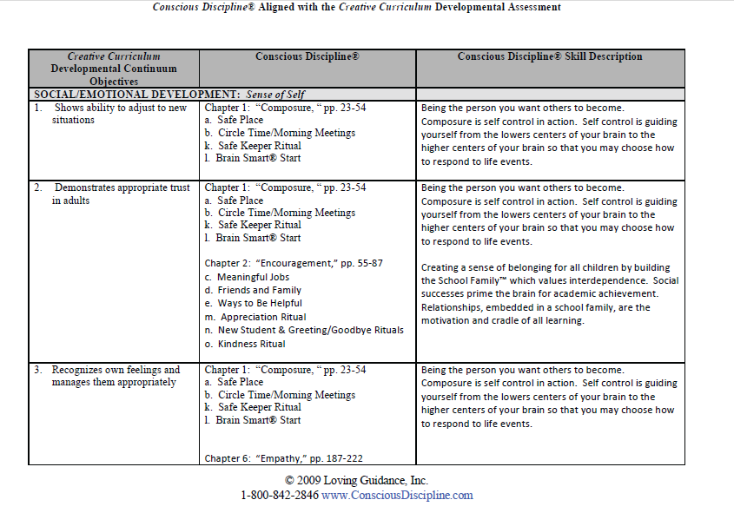
Conscious Discipline aligns with the curriculum we use, Creative Curriculum
(Loving Guidance, Inc., 2009)
Notes:
This past school year, in our grade level P.L.C.'s, we created a “Pre-K Must Knows” sheet and a report card to give parents based on the objectives in Creative Curriculum. As we worked on assessments, we realized that the objectives were very subjective. This year, using the alignment tool, it will be easier to evaluate my students consistently, as I can consider how they respond to the strategies that I have integrated into our classroom. When I first started at my job, I indicated to my supervisor that I wanted to use ideas in Champs. This suggestion did not go over well by her. She told me I needed to use Positive Behavior Supports as we had just received (very minimal) training in it. At the time I didn’t realize that Champs was a research based PBS model, or I would have defended myself. Based on that experience, I know that if I am planning to implement a specific program, it will be imperative that I show it can be used within the framework that is already in place for our program. I debated if I should only include one slide indicating how Creative Curriculum and Conscious Discipline aligned. I decided I would include all of them, so that I had them available to show that they aligned consistently throughout the objectives.

Slide 44
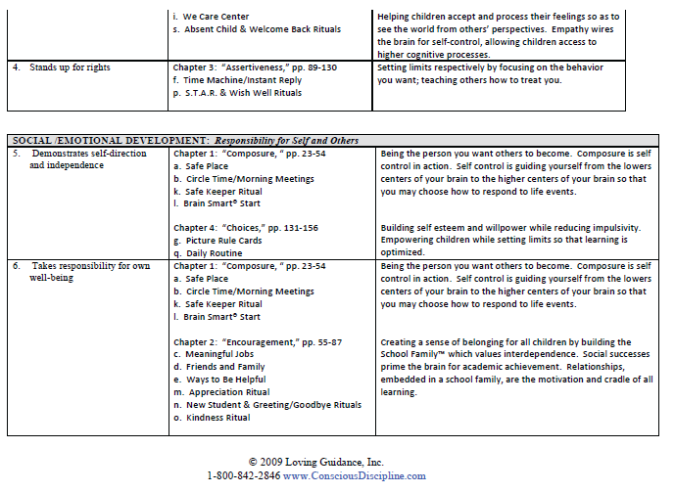
(Loving Guidance, Inc., 2009)

Slide 45
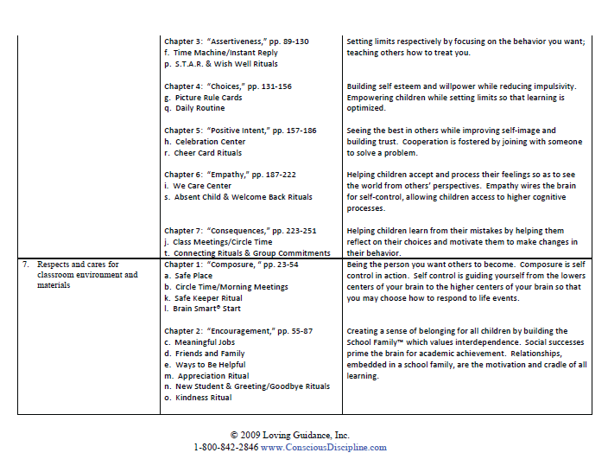
(Loving Guidance, Inc., 2009)

Slide 46
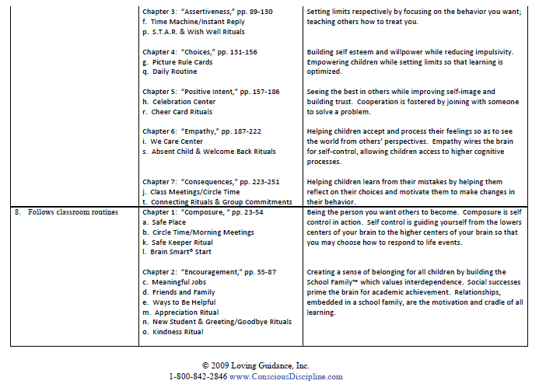
(Loving Guidance, Inc., 2009)

Slide 47
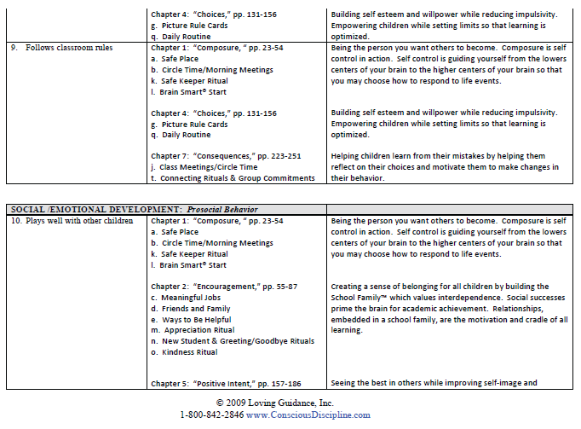
(Loving Guidance, Inc., 2009)

Slide 48
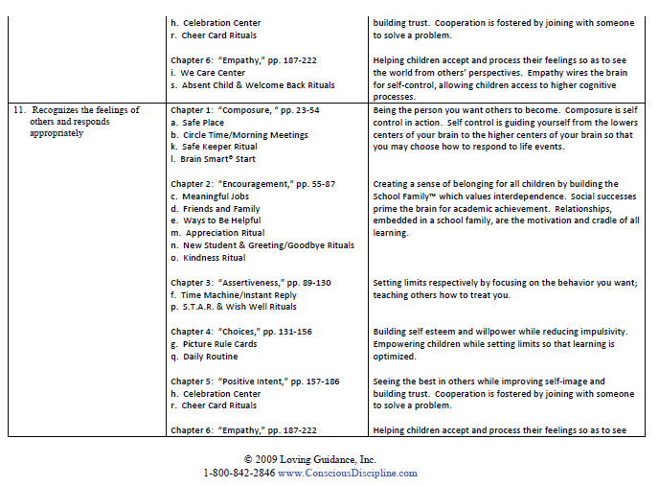
(Loving Guidance, Inc., 2009)

Slide 49
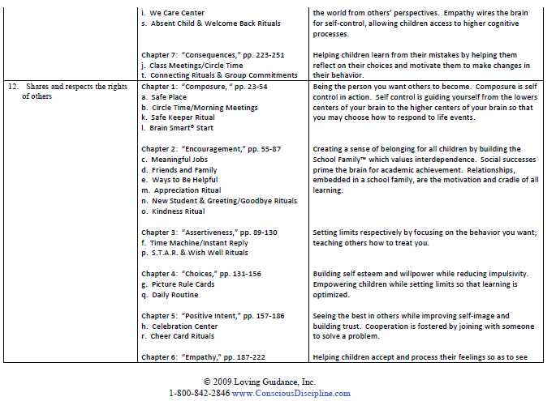
(Loving Guidance, Inc., 2009)

Slide 50
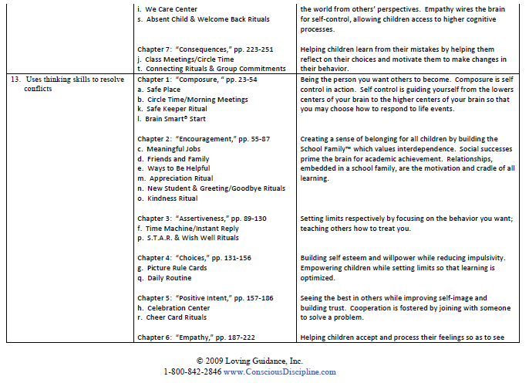
(Loving Guidance, Inc., 2009)

Slide 51
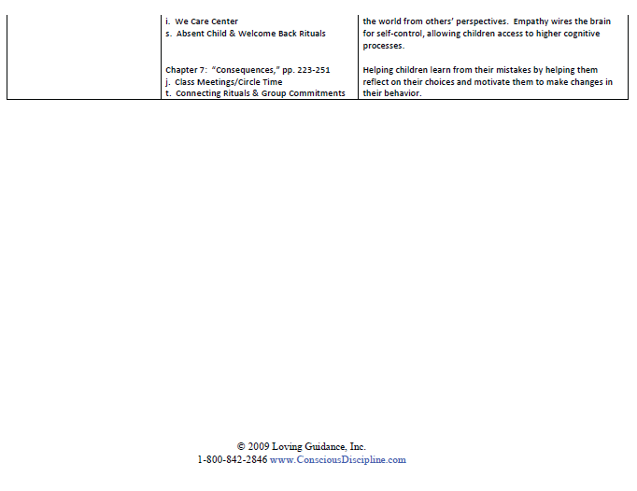
(Loving Guidance, Inc., 2009)

Slide 52
Limitations
My research found limited information reviewing the effectiveness of incorporating Conscious Discipline into school practice. This may due to complexity of the program.
Requires consistency by classroom teachers
Can not leave a structured “discipline plan” for substitutes.
Requires time and persistence to implement strategies into teaching practice.
Notes:
With any research, it is important to also consider limitations or problems. As I have spent a considerable time researching the program, I have a far better understanding of it then an individual would have by just viewing my slideshow. In addition, I have had the summer to practice and incorporate Bailey’s self-control principles into my life. As I have used my skills when my children have conflicts, I have noticed that it can be difficult to incorporate the techniques when my husband is not using them.

Slide 53
Bibliography
Bailey, B. A. (2001). Conscious Discipline. Oviedo, FL: Loving Guidance, Inc.
Bailey, B. A. (2011). The Theoretical and Scientific Basis of Conscious Discipline®. Retrieved June 2012, from Conscious Discipline®: http://consciousdiscipline.com/downloads/research/Theoretical%20and%20Scientifi c%20Basis%20of%20Conscious%20Discipline.pdf
Hoffman, L. L., Hutchinson, C. J., & Reiss, E. (2009). On improving school climate: Reducing reliance on rewards and punishment. International Journal of Whole Schooling, 5(1), 13-24. Retrieved from: http://ezproxy.msu.edu/login?url=http://search.proquest.com/docview/61896844?ac countid=12598
Jones, V. F. (2009). Comprehensive classroom management, Creating communities of support and solving problems (9th ed.). Boston: Allyn & Bacon.

Slide 54
Bibliography, continued
Loving Guidance, Inc. (2005). Safe Breathing Icons. Retrieved June 2012, from Conscious Discipline®: http://consciousdiscipline.com/downloads/resources/Safe_Place_Breathing_Icons.pdf
Loving Guidance, Inc. (2009). Conscious Discipline® Aligned with the Creative Curriculum Developmental Assessment. Retrieved June 2012, from Conscious Discipline®: http://consciousdiscipline.com/downloads/resources/alignments/Conscious%20Discipli ne%20Aligned%20with%20the%20Creative%20Curriculum%20Developmental%20Ass essment.pdf
McDaniel, T. R. (2008). Review of Conscious Discipline: 7 basic skills for brain smart classroom management. The Clearing House, 81(6), 282-283. Retrieved from: http://ezproxy.msu.edu/login?url=http://search.proquest.com/docview/196844823?acco untid=12598
Sprick, R. G. (2009). CHAMPs: A proactive and positive approach to classroom management (2nd ed.). Eugene, OR:Pacific Northwest Publishing.

